Slide 1









Identity
Insights

Slide 2


Agenda
Intro
Assumptions
The user / permission governance problem
How to start
Insights are missing
Identity Insights components
Demo

Slide 3
Intro
Wim van den Heijkant
Aged 39, happily married, father of two.
Full time Microsoft Identity consultant for over 15 years now. MIIS, ILM, FIM, MIM, BPOS, Azure AD, EntraID
Co-founder and proud member of Identity Consultancy “Maatschap Fortigi”

Slide 4
Intro
Build cool things
Working with Port of Rotterdam.
Cool place to work, allowed me to share, to open source…
My journey into understanding our IGA problem, learning PowerBI

Slide 5
Assumptions
You have done the basics
Automated provisioning (from HR)
MFA, Conditional Access
Single Sign-On & SCIM
Just in Time Access to critical stuff
On a path to transition from AD to EntraID
What's next…?

Slide 6
Governance
Identity Governance & Administration (IGA) “Governance is the process of making and enforcing decisions”
IGA is about finding a way to “know” that the right users have the right permissions at the right time.
1) https://en.wikipedia.org/wiki/Governance

Slide 7



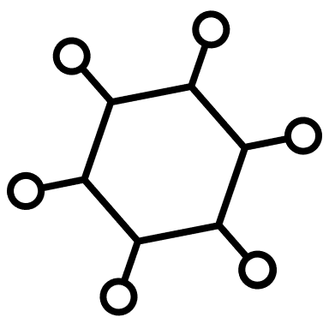
User / permission governance
Users
Permissions
Lots of combinations

Slide 8




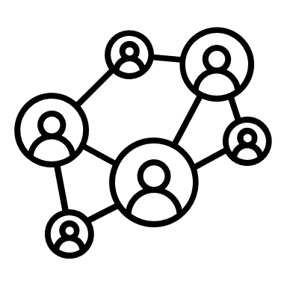
User / permission governance
Users
Permissions
Lots of combinations
Source of record
Chain of responsibility

Slide 9

User / permission governance
Users
Permissions
Lots of combinations
Source of record
Chain of responsibility
Link to Application
Link to team / owner

Slide 10

User / permission governance
Users
Permissions
Lots of combinations
Lots of combinations
Lots of changes over time
Multiple people might have an opinion

Slide 11
User / permission governance
How do we implement; “the process of making and enforcing decisions”
around user permissions
How do we;
“know” that the current user / permission combinations are correct
1) https://en.wikipedia.org/wiki/Governance

Slide 12
How to start
Where to start?
How big is this problem?
How hard can it be?
Because you must, not because you want to..
How to convince management?
Lots of combinations

Slide 13
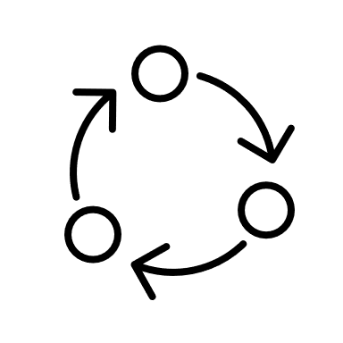

Entra Identity Goverance
Life cycle workflows
Access Governance
Access packages
Request & Approve
Dynamic
Governance
Access Review
Approval logs
Grace periods

Slide 14
Insights are missing
How many users do we have?
How many permissions do we have?
How many combinations do we have?
How often do they change?
Why can we just use dynamic groups or scripts?
Can’t the helpdesk just fix this?
Which users should get which permissions?
In other words,… why is this a hard problem to solve?
Lots of combinations

Slide 15
Our data…
4663
8815
159945

Slide 16
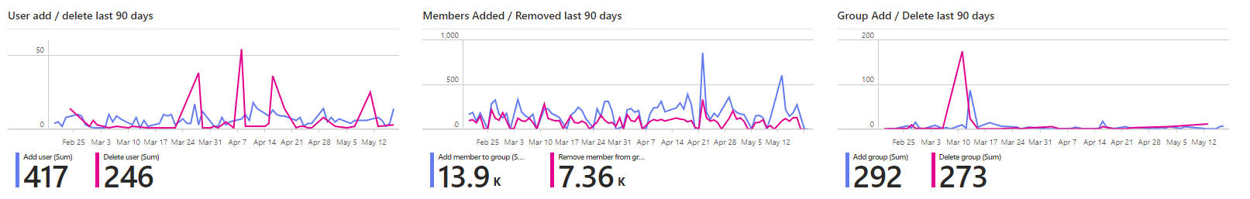
Our data…
4663
8815
159945
39 changes last week
1976 changes last week
28 changes last week

Slide 17
As I said…
Users
Permissions
Lots of combinations
Lots of combinations
Lots of changes over time

Slide 18








Identity
Insights

Slide 19






Identity Insights
Scripts collect data
Scheduled in automation
JSON Files
Stored in Blob Storage
Joined & structured
Using Power Query
Insights using
PowerBI

Slide 20
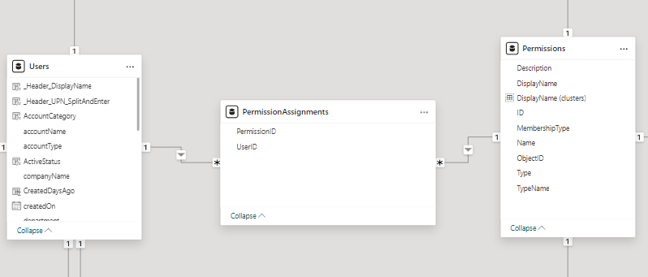
Identity Insights
Data model
There is no ID in EntraID, there is only user.

Slide 21
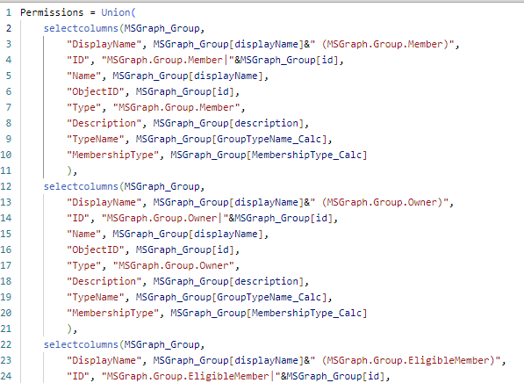
Identity Insights
Unions & Mappings make it flexible

Slide 22
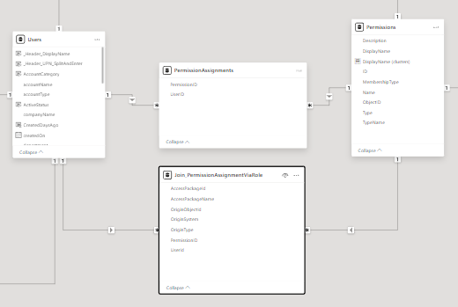
Identity Insights
Permission Assignment via Access Package

Slide 23


Identity Insights
PowerBI
Excel
Adding notes to your Power BI data

Slide 24

Demo

